Slide 1


Wrap-up
CUAHSI
HIS
Sharing hydrologic data
http://his.cuahsi.org/
Jeffery S. Horsburgh
Utah Water Research Laboratory
Utah State University
Support
EAR 0622374

Slide 2
Next Steps
Once your data are loaded into an ODM database and you want to publish them
Create a WaterOneFlow Web Service
Register your service at HIS Central
Tag your variables to the search ontology

Slide 3
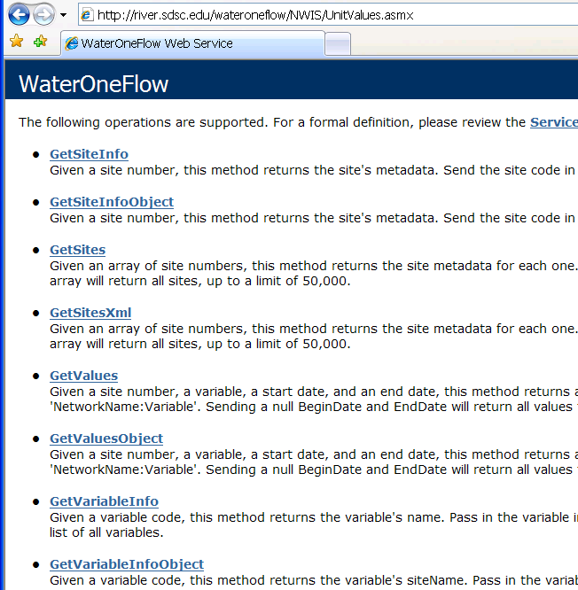
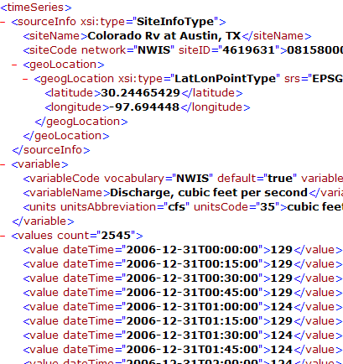
Publishing Data in an ODM Database
WaterML and WaterOneFlow
WaterML is an XML schema for communicating water data
WaterOneFlow is a set of web services based on WaterML
Set of query functions
Returns data in WaterML
Notes:
3

Slide 4
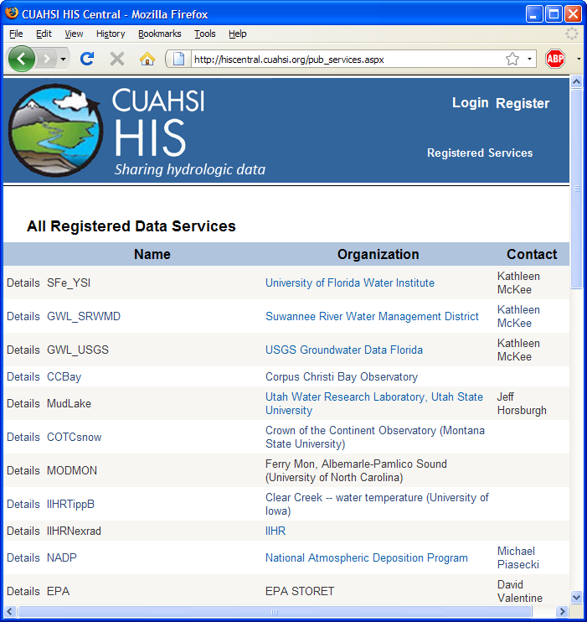
Registering a WaterOneFlow Web Service with HIS Central
Publishers
Register a data service
Users
Find a data service
Components
Service registry
Metadata catalog
Ontology
Search services
http://hiscentral.cuahsi.org

Slide 5
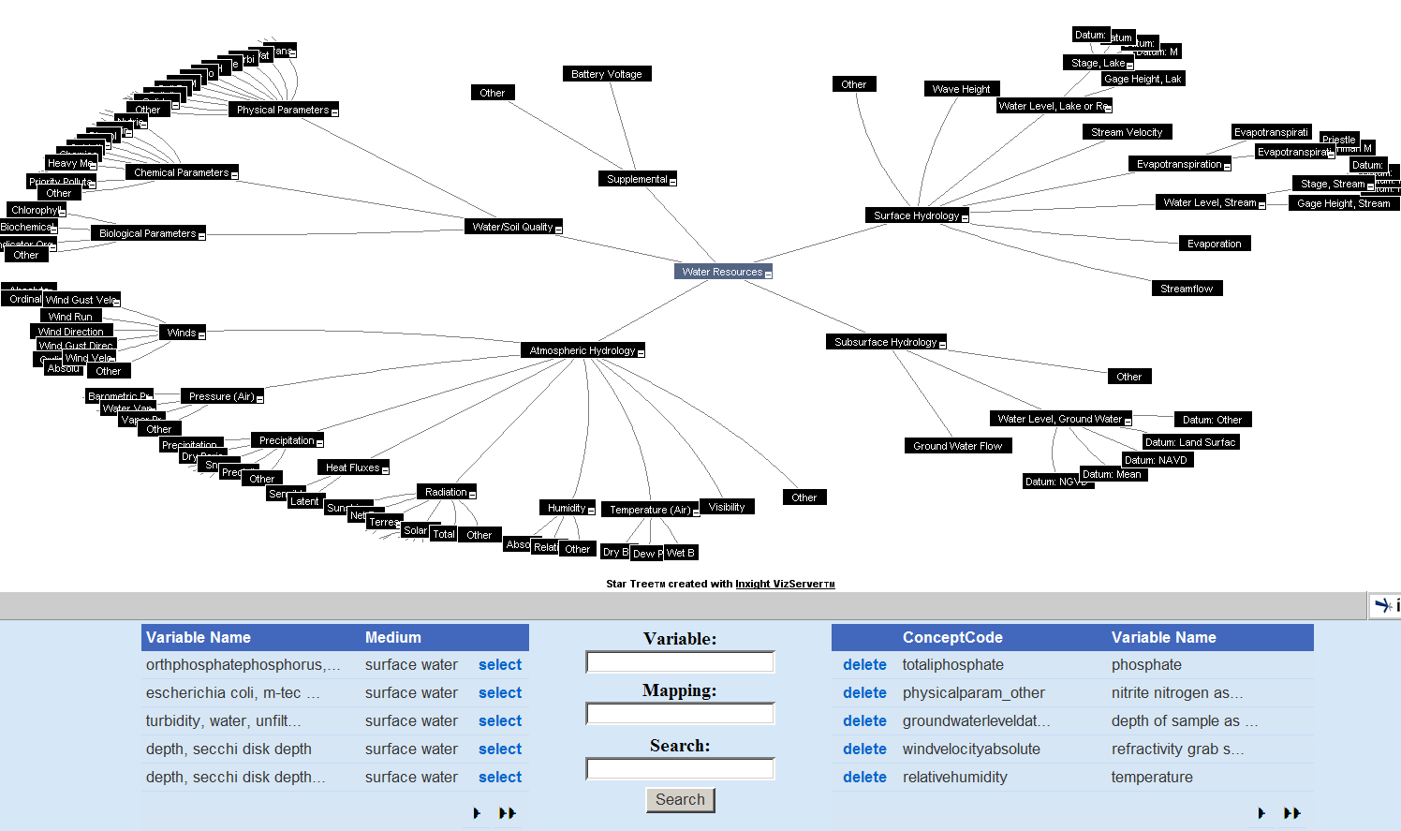
HydroTagger
Ontology: A hierarchy of concepts
Each Variable in your data is connected to a corresponding Concept

Slide 6
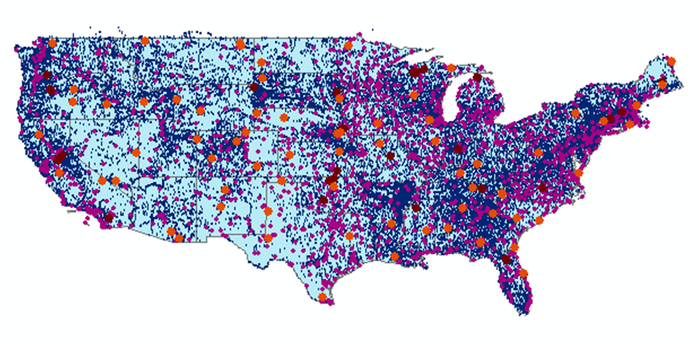
HIS Central Catalog

Slide 7
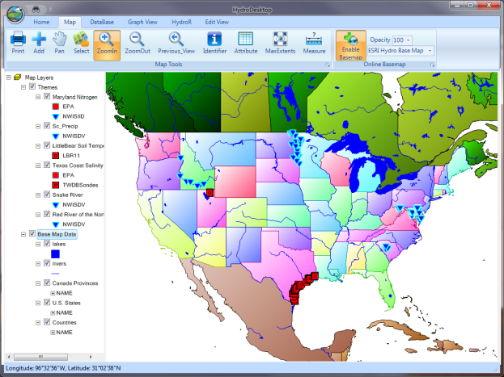
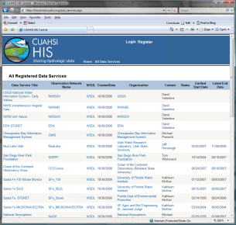
HydroServer Distributed Water Data Services
National Dataset Water Data Services
ODM
ODM
ODM
ODM
ODM
NWIS
STORET
DAYMET
SNOTEL
…
WOF
WOF
WOF
WOF
WOF
WOF
WOF
WOF
WOF
WOF
HydroDesktop
HIS Central
Metadata
Harvesting
Web Service Calls
WaterML
Desktop Analysis Software
Database API
Metadata
Catalog
R
Desktop Data
Repository
Search, Download, and Manage Data Subscriptions
Data Discovery
Calls
Metadata Services
MATLAB
Excel
Variable
Mapping
Visualize and Summarize (TSA)
Workflow
Convert Units
Ontology
Ontology
Services
Convert Formats and Export
Files
Import
HydroDesktop
Plug-ins
Files

Slide 8
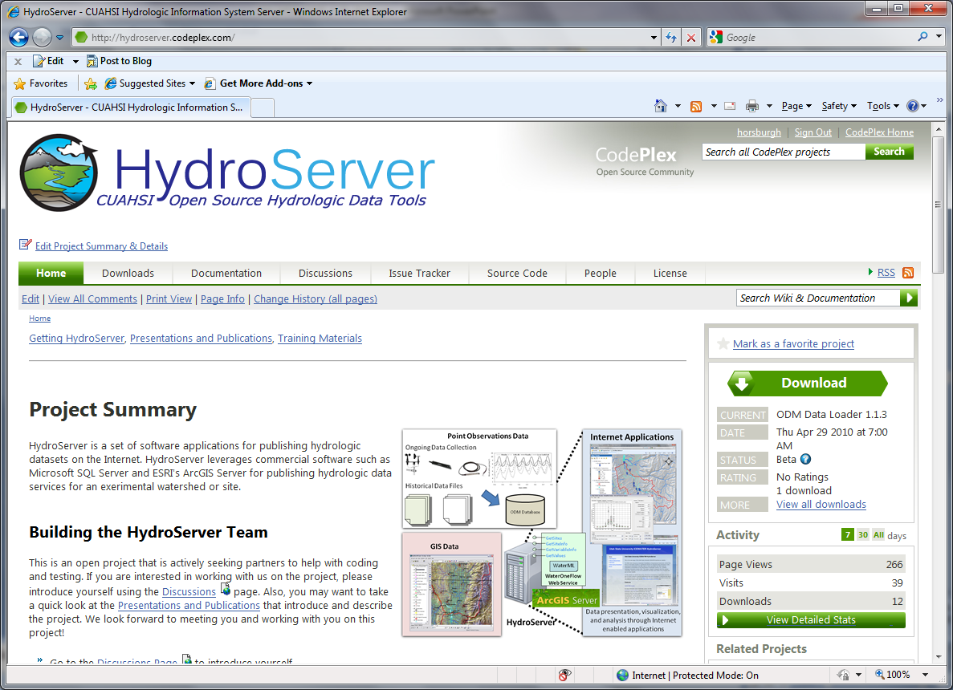

Slide 9
http://hydroserver.codeplex.com Summary of Features
Project description – what is HydroServer
Downloads – get the software
Documentation – what to do once you have the software
Discussions – getting help with specific questions
Issue Tracker – reporting issues or feature requests
Source Code – download the source code and contribute

Slide 10
How do I create a HydroServer?
Get a Windows Server Machine with IIS and .Net Framework
Install Microsoft SQL Server
Install HydroServer Software from his.cuahsi.org
ODM and Utilities
WaterOneFlow web services
HydroServer Website, TSA, Map, Capabilities
Install ArcGIS
Create data services and document them in the capabilities database
Register your services with HIS Central and register your variables with the HIS Ontology so your data will be searchable

Slide 11
System Requirements
Required Hardware (Generally less than $5000)
Can be one or more physical or virtual machine(s)
Dual or quad-core processor at 2+ GHz
> 4 GB of RAM
> 500 GB of hard drive space
Network adapter
Required Commercial Software
Microsoft Windows 2003 or 2008 Server (preferred)
IIS Web Server
.NET Framework Version 3.5
Microsoft SQL Server 2005 or 2008 (preferred)
Any edition – Express (free), Standard, Enterprise
ESRI ArcGIS Server 9.3.1

Slide 12
Network Requirements
A HydroServer must be on a network where it is publicly available
May want to establish a domain
e.g., http://icewater.usu.edu

Slide 13
Questions?
CUAHSI
HIS
Sharing hydrologic data
http://his.cuahsi.org/
Support
EAR 0622374

